Slide 1
THINGS TO EDITED
Intro/goal slide:
  Maybe clarify what a state data center is? Some people might not have heard of them
Topic modeling gensim slide:
  Maybe color/highlight the repeated words in each topic (e.g. red for law, purple for amendment across topics)
Clarify: In which methods do you specify the number of topics? Or was it all unsupervised
What goes into evaluating if a website is scrapable? Did you have rubric or a set of criteria?
  Maybe show an example of a scrapable versus non scrapable website
In general, I might assume the audience has less background on methods. They might not know what topic modeling is, what web scraping is. Maybe add more information on these things in the slides.
Add a project overview? Why we are doing this project, what census wants...
Add page numbers for people to reference
Include all team members, also sponsor
Example of scrapable website and not scrapable website

Slide 2

Census & Resilience Project
Marijke van der Geer, Jianing Cai

Slide 3
Census Project Goals
Goal 1: Identify data needs in State Constitutions
  Does the constitution mention the use of data?
  What kind of data would be helpful in assisting the state?
  Goal 2: Identify data tools and data applications in State Data Centers
  Is the tool/application developed based on Census data?
  Does the data center in each state use data sources other than Census?

Slide 4
Goal 1:
Identify data needs in State Constitutions

Slide 5
Approaches
Manual Search
Topic Modeling
  Gensim
  BERT

Slide 6
Manual Search
Collection of constitutions
  50 pdfs of state constitutions
Searched 2 constitutions each for key words
  Data, census, information, etc
Look for adjectives that could be "tested" by data
  Minimum, maximum, annual, etc

Slide 7
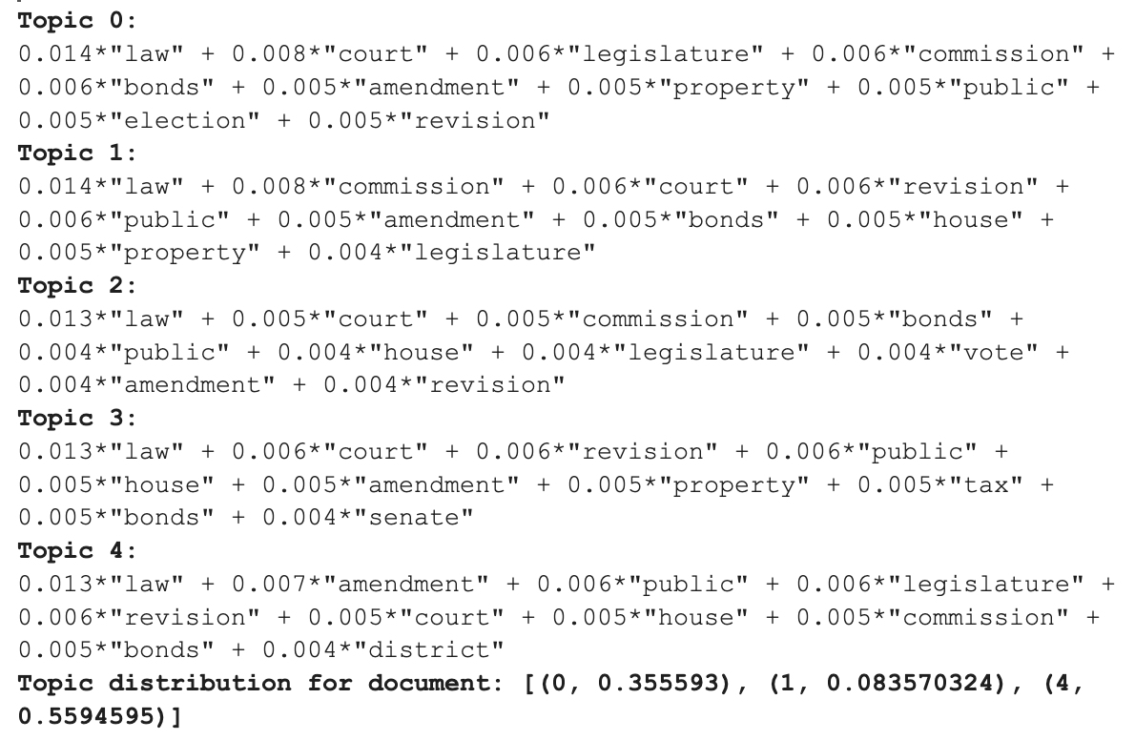
Topic Modeling using GENSIM
Combine VT, VA, FL state's constitution together
Result:
  Repetitive words and topic group
  Have to manually exclude words

Slide 8
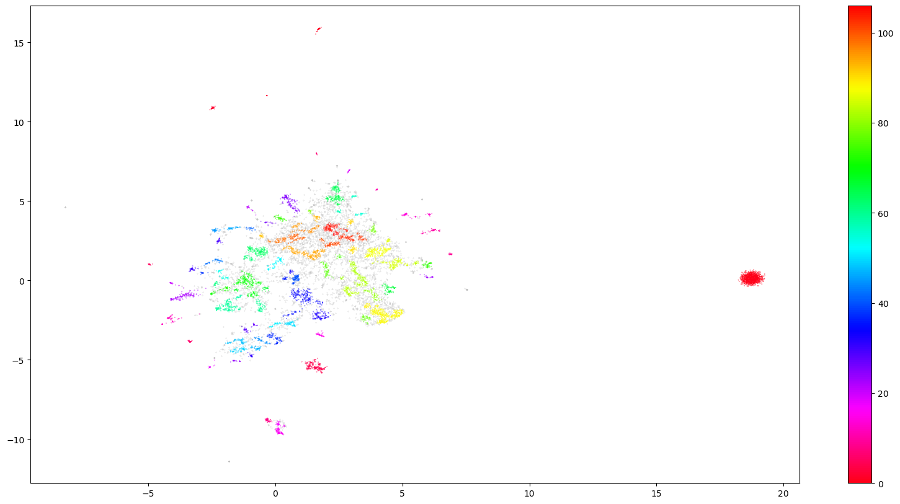
Topic Modeling using BERT
Top 5 states with the most constitutional amendments
  CA, TX, HI, OR, MD
108 topics

Slide 9
Goal 2:
Identify data tools and data applications in State Data Centers

Slide 10
Approaches
Web Scraping
  Link Collection
  Colorado SDC Site
Assessment of State Data Centers

Slide 11
Link Collection
Lead and secondary agencies
Combination of code to scrape links and agency names
Numerous types of agencies
  Universities, Libraries, Research Centers
Determined whether sites for state data centers are scrapable

Slide 12
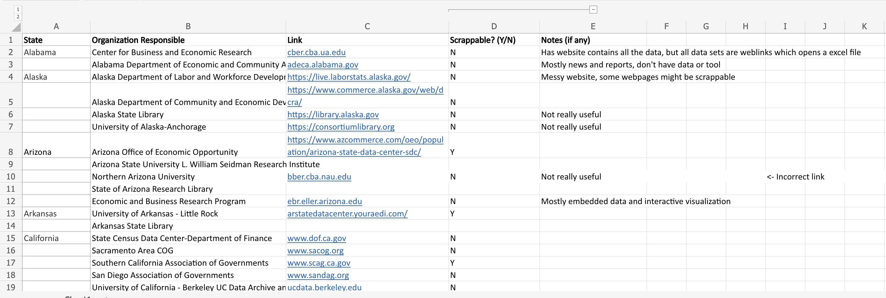

Slide 14
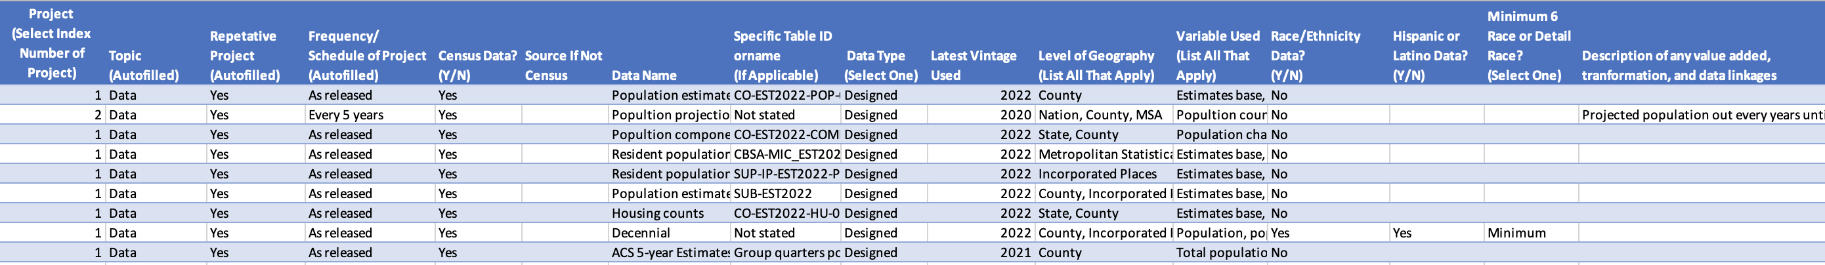
Example: Colorado SDC Site
Manual search vs. web scraping

Slide 15
Next Steps
Further analysis of state data centers
  Collect data and group our findings by different categories
Creation of interactive webpage
  Data visualization

Slide 16
THANKS!

